Slide 1
XGBoost Regression
Extreme Gradient Boosting

Slide 2
What is XGBoost?
XGBoost stands for Extreme Gradient Boosting
Advanced version of Gradient Boosting
Uses regularization to avoid overfitting
Faster and more efficient than traditional boosting

Slide 3
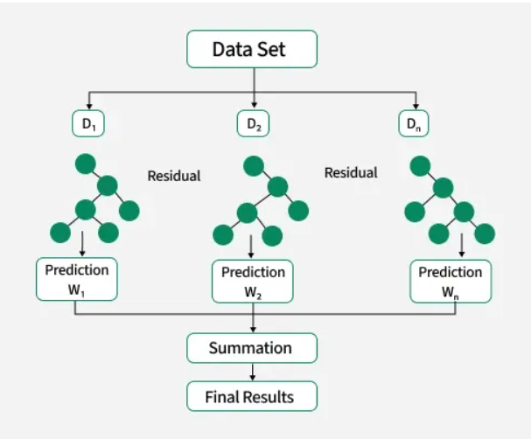
XGBoost diagram

Slide 4
Working of XGBoost
Models are built sequentially
Each model learns from previous residual errors
Uses gradient descent to minimize loss
Strong focus on performance optimization

Slide 5
Advantages & Limitations
Advantages
High accuracy
Handles missing values
Built-in regularization
Limitation
Complex to tune
Requires extra library installation

